Slide 1
Web Development Log

Slide 2
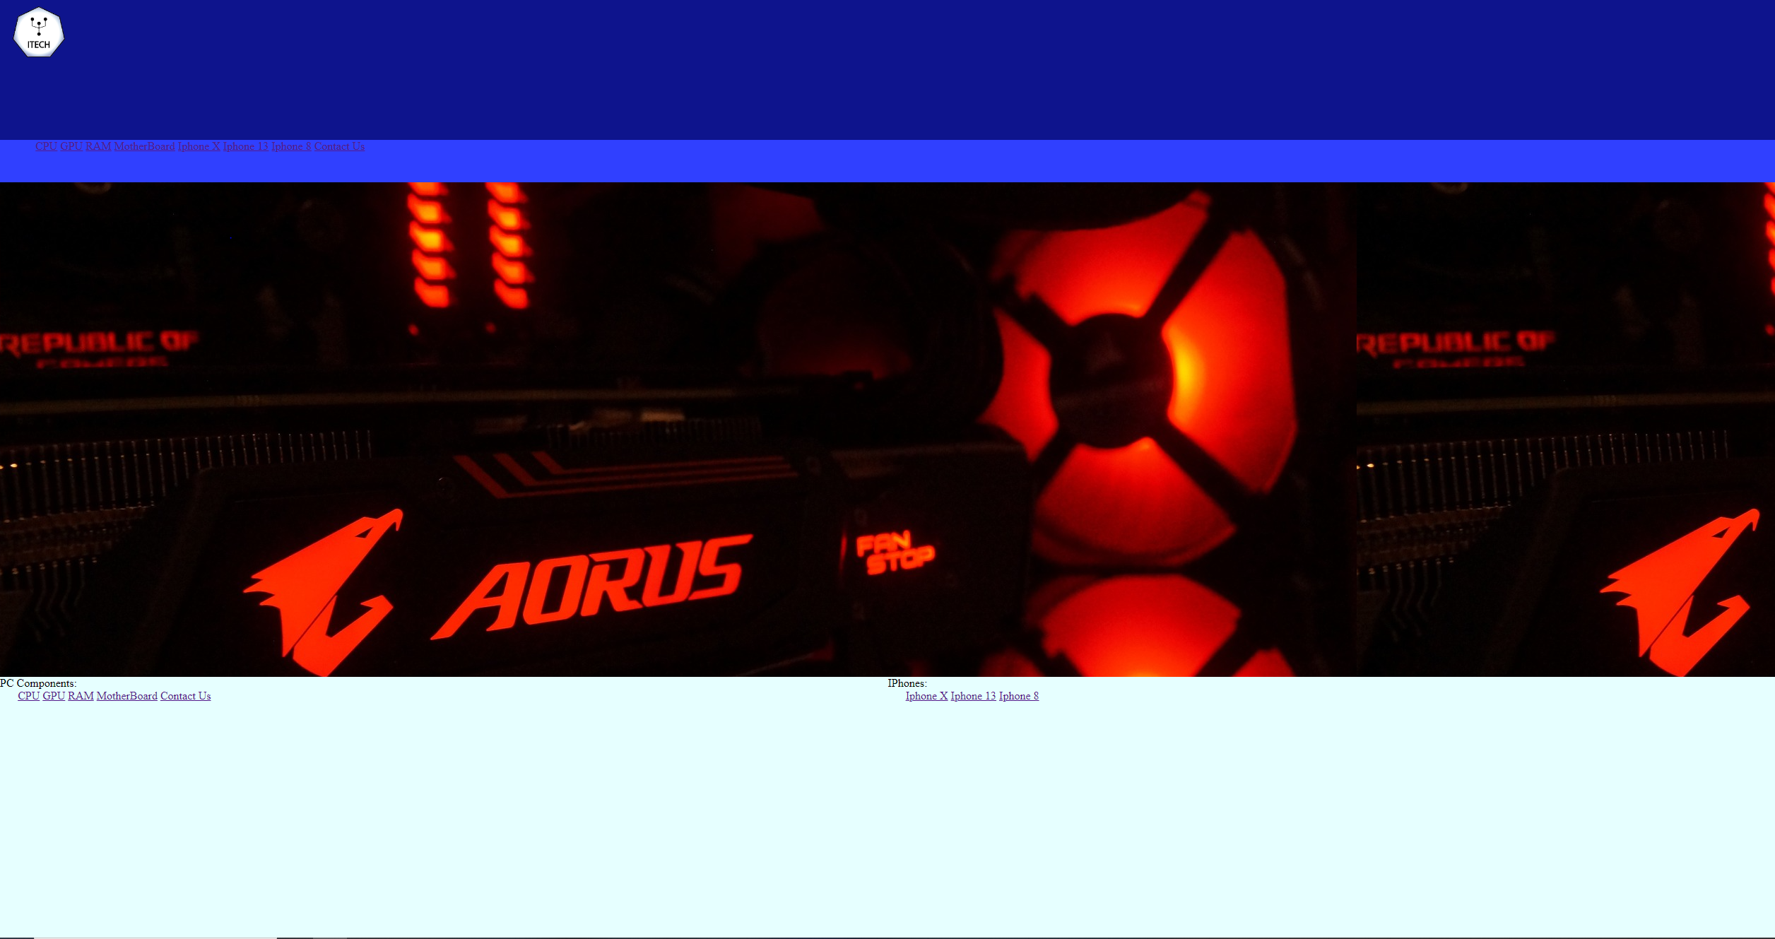
01/02/2023
Today I expanded the navigation bar, added more pages and added the two secondary navigation boxes for the home page
No issues were encountered

Slide 3

08/02/2023
Today I added some text boxes ready for information on all of the pages, I began drafting some of the text to go on my website. I have also decided to go with slideshows on all of the pages as opposed to 4 separate images and might only do 2 text boxes per page to make it seem less cramped
I learnt today how to use html and css differently to be able toad images in different ways and organisation
Next lesson, I will have to add the text onto the pages, add a footer for accessibility and alter the images some more

Slide 4
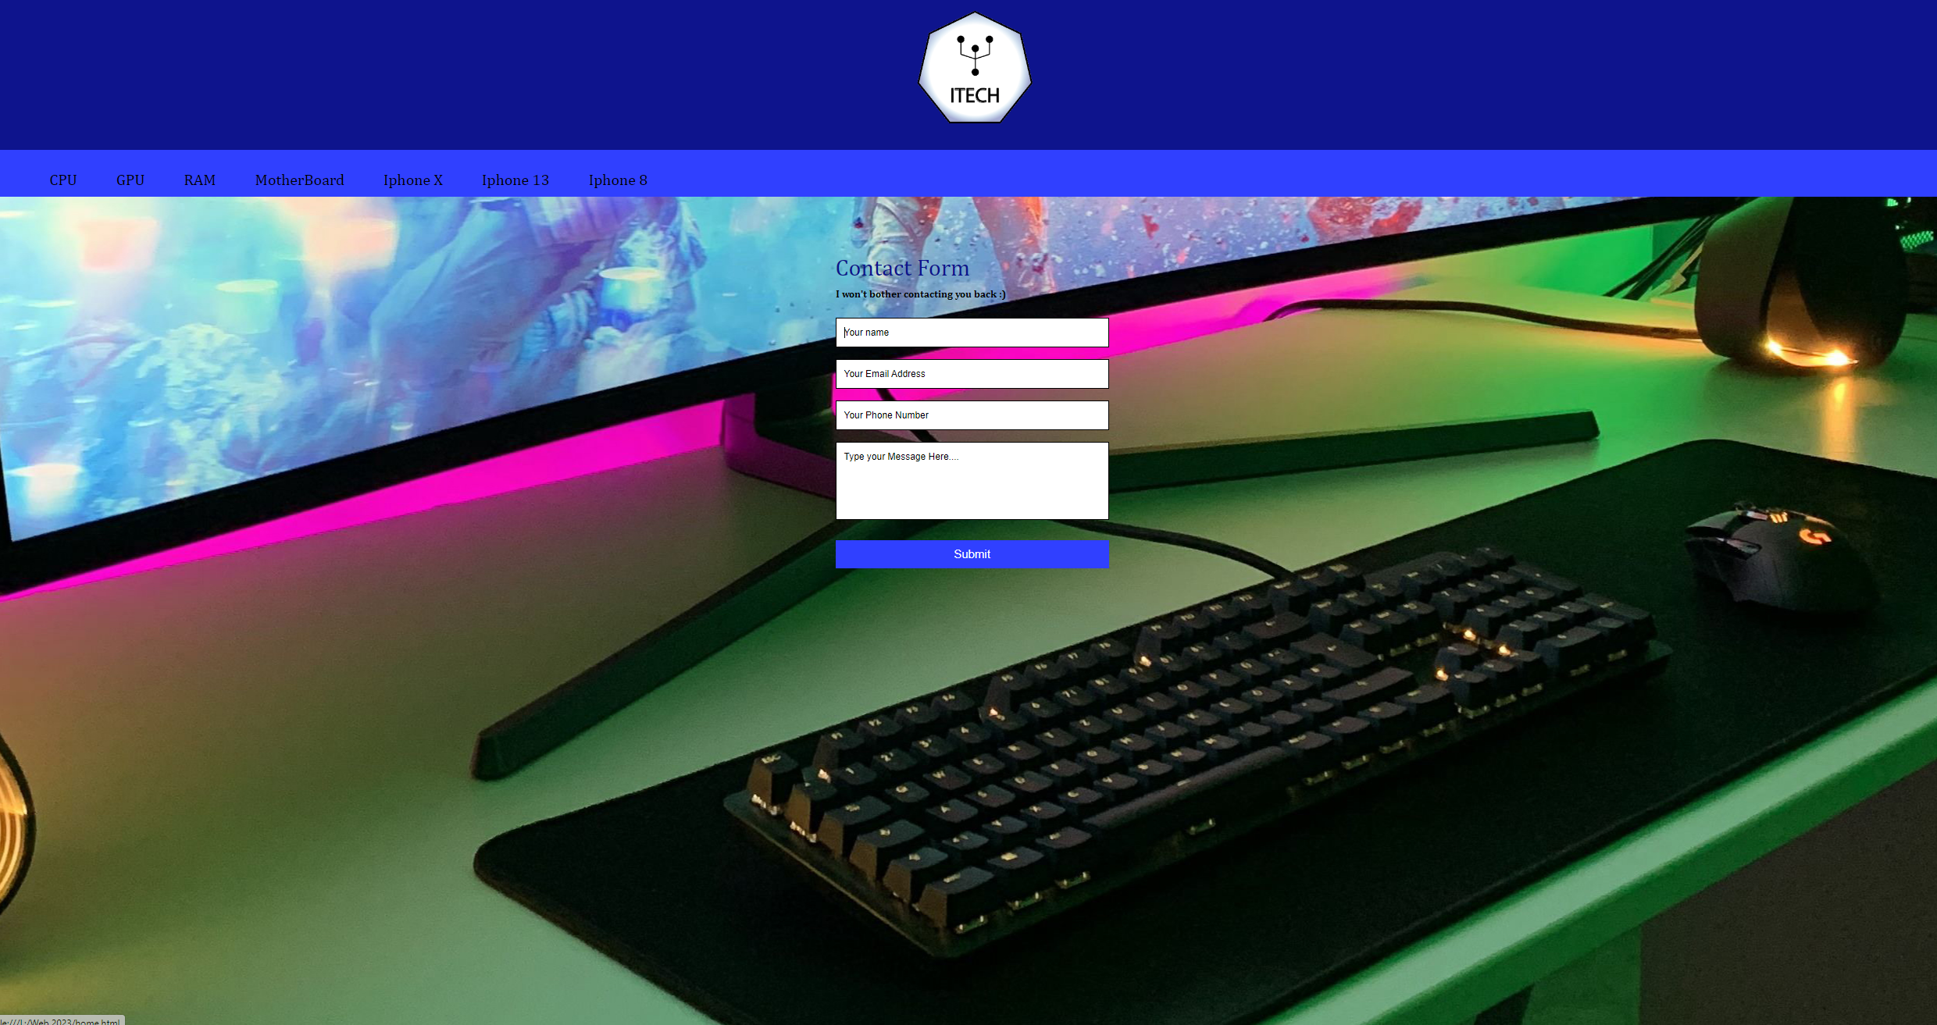
03/03/2023
Today I added a contact form as well as fully sized all the background images and began to insert information text onto the pages
Next week I will finish the texts and finalise my website

